Slide 1
Chapter 37 Alternating Current Circuits

Slide 2
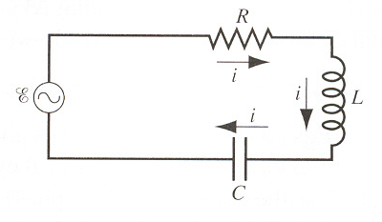
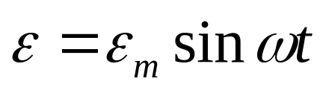
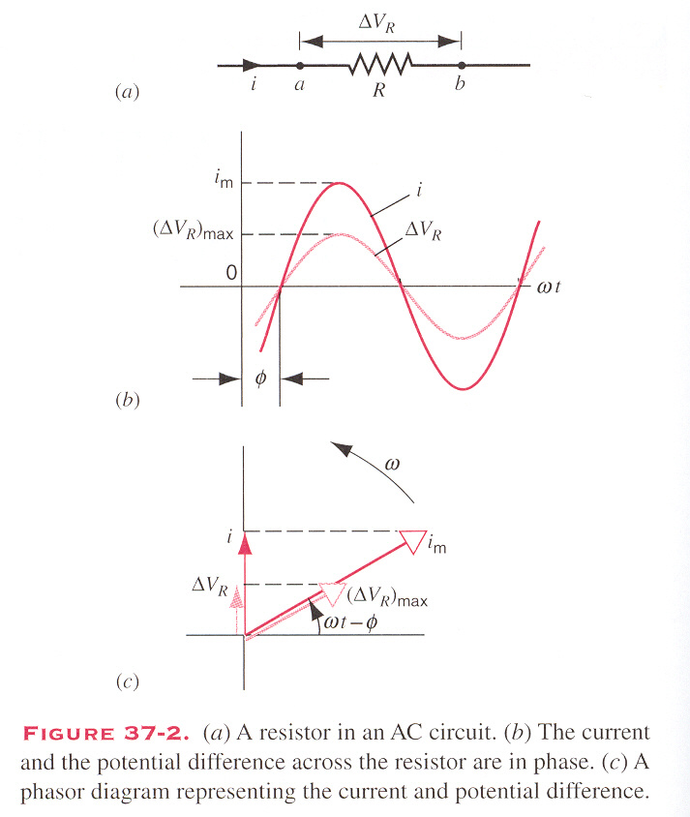

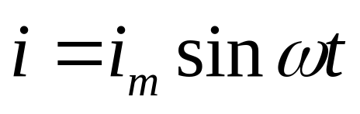

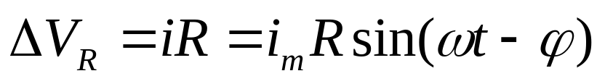
Alternating current (AC)
A Resistive Element
ΔV_{R} and i are in phase.

Slide 3
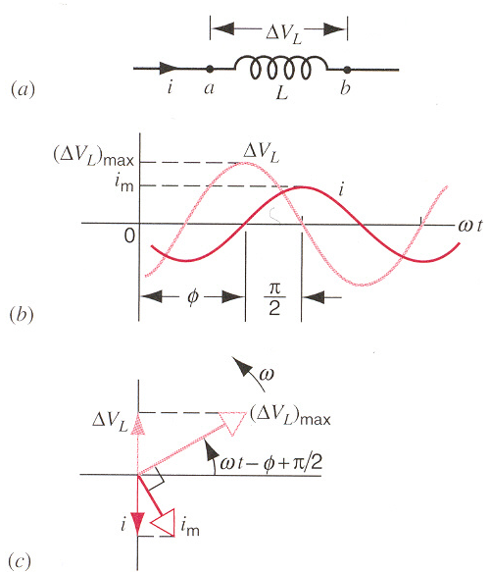
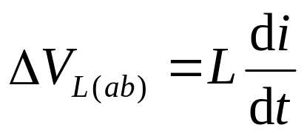
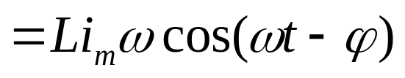
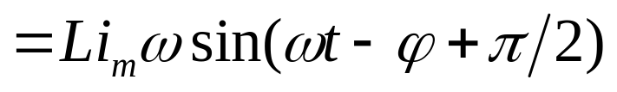
Alternating current (AC)
A Inductive Element
ΔV_{L}
i
L
out of phase, with i behind ΔV_{L}

Slide 4
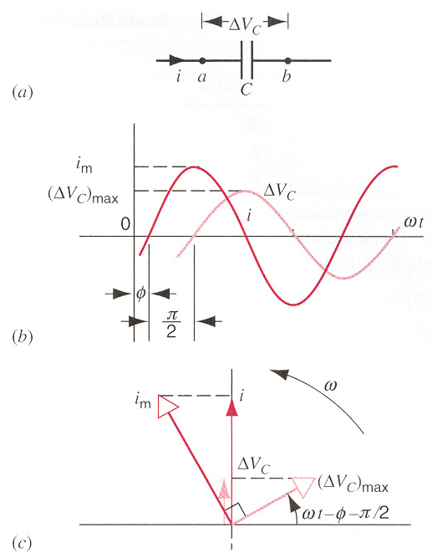
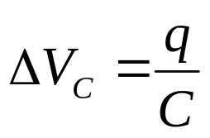
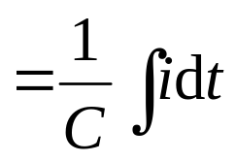
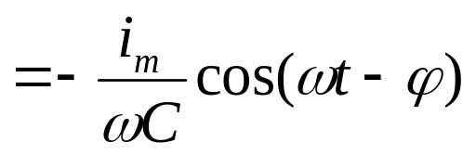
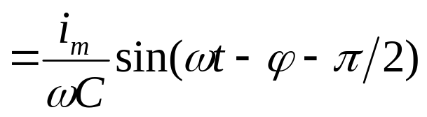
Alternating current (AC)
A Capacitive Element
ΔV_{C}
i
C
out of phase, with i ahead of ΔV_{C}

Slide 5
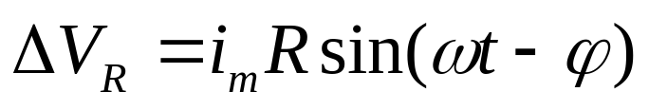
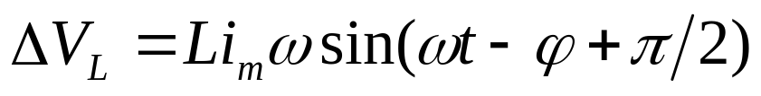
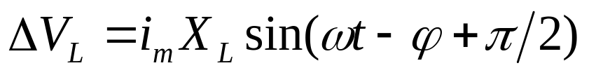
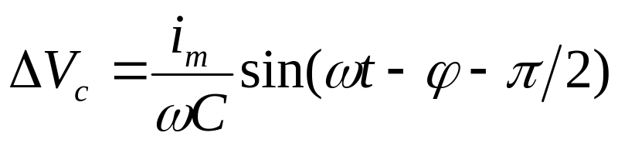
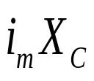
Alternating current (AC)
ε-ΔV_{R}- ΔV_{L}- ΔV_{C} =0
Reactance R
in phase
Inductive reactance X_{L}=ωL
out of phase
Capacitive reactance X_{C}=1/(ωC)
out of phase

Slide 6
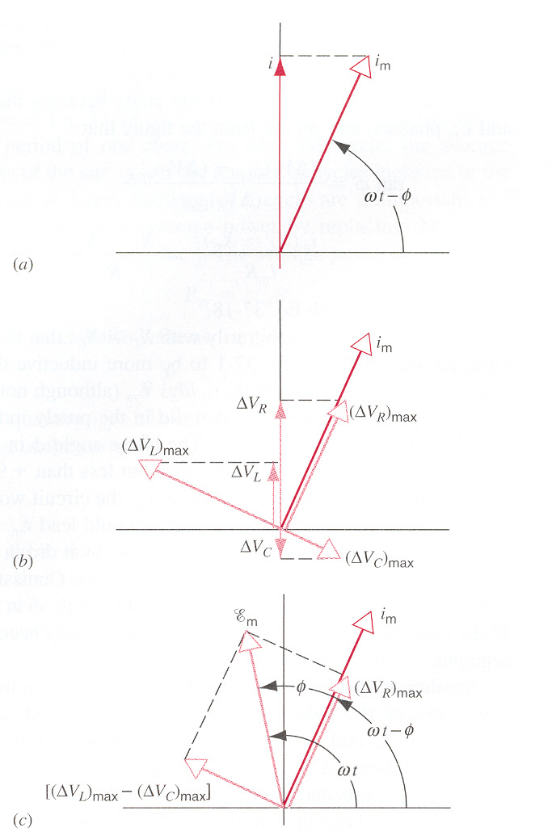
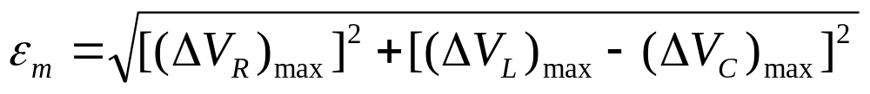


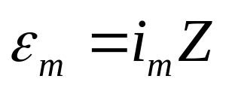

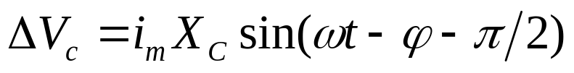

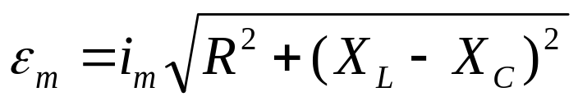
Alternating current (AC)
ε-ΔV_{R}- ΔV_{L}- ΔV_{C} =0
impedance

Slide 7
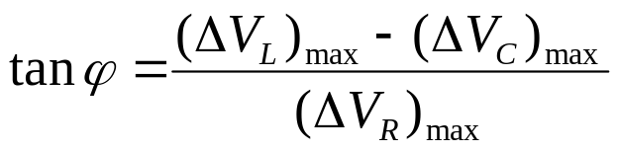
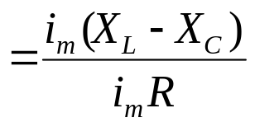
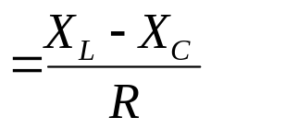
Alternating current (AC)
ε-ΔV_{R}- ΔV_{L}- ΔV_{C} =0
If X_{L} > X_{C} , more inductive circuit, φ is positive but less than 90º.
If X_{C} > X_{L} , more capacitive circuit, φ is negative but less than 90º.
If X_{C} = X_{L} , φ =0º.
resonance

Slide 8
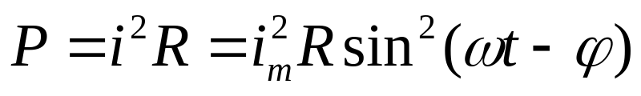
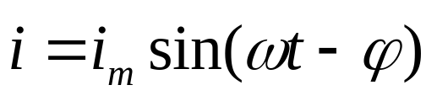
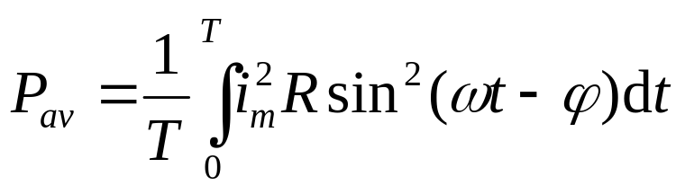
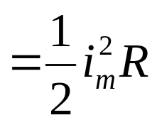
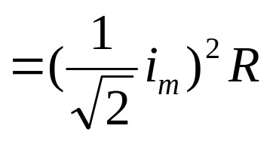
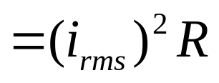
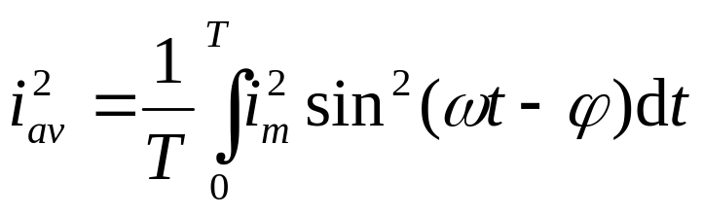
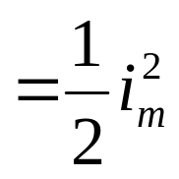
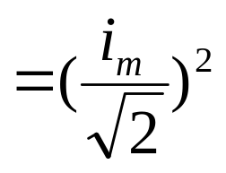
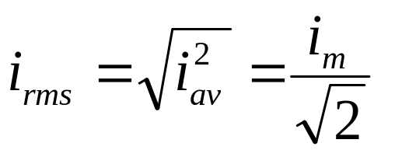
Power in AC Circuits
Average power
“Root-mean-square” Current

Slide 9
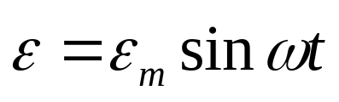

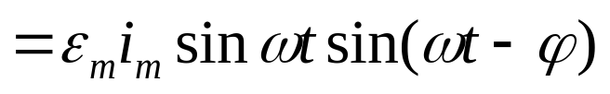
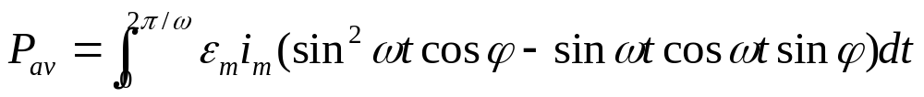
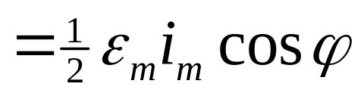
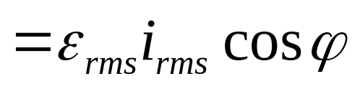
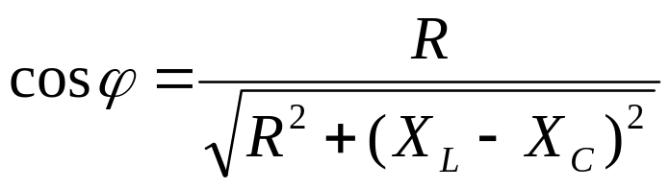
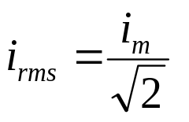
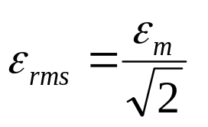
Power in AC Circuits
Power of EMF
power factor “cosφ”
P_{av} maximum
X_{L}=X_{C}, Z=R

Slide 10
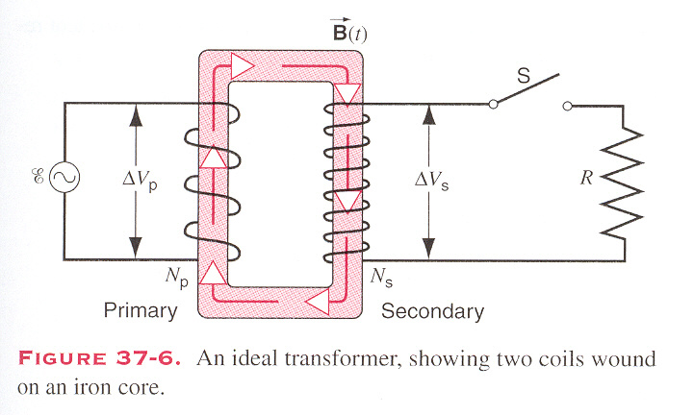
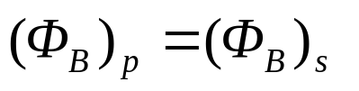
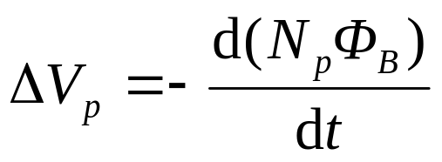
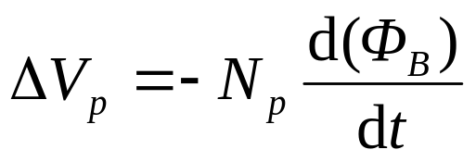
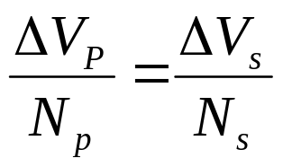








The Transformer
Changing ΔV
i_{p}
Z_{eq}
Changing Ζ

Slide 11





In DC circuit
R
ε, r
R↓,i↑. But i↑, ir ↑,ΔV_{R} ↓.
R=r is matching condition of load and source.

Slide 12

This conclusion can be expanded to AC circuits.
ε=6V, the interior resistance r=100Ω, the resistance of speaker R=8Ω.
Example
transformer
Find the power if the speaker join up with the source directly.

Slide 13


This conclusion can be expanded to AC circuits.
ε =6V, the interior resistance r=100Ω, the resistance of speaker R=8Ω.
Example
transformer
N_{s}=300, N_{p} =100.

Slide 14


This conclusion can be expanded to AC circuits.
ε=6V, the interior resistance r=100Ω, the resistance of speaker R=8Ω.
Example
transformer
N_{s}=353, N_{p} =100.
=P_{max}

Slide 15
Exercises
P856-857 7, 11, 15, 19, 25

Slide 16


















Slide 17





In AC circuit
R
ε, r

Slide 18






In AC circuit
X_{L}
ε, r

Slide 19






In AC circuit
X_{C}
ε, r

